Slide 1
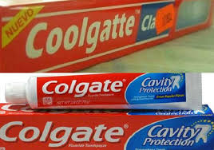
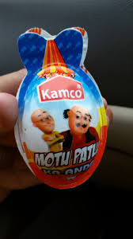
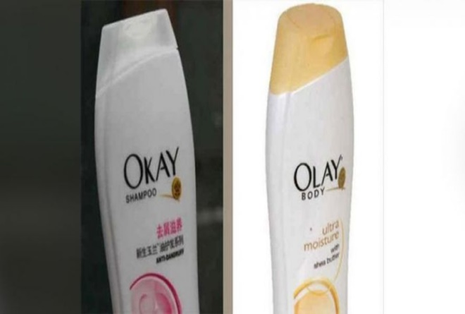
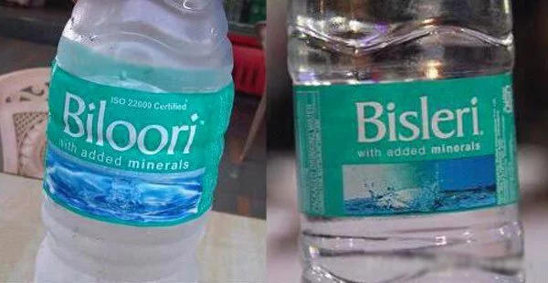
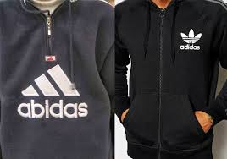
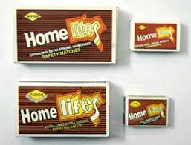

Slide 2
https://qz.com/771727/chinas-factories-in-shenzhen-can-copy-products-at-breakneck-speed-and-its-time-for-the-rest-of-the-world-to-get-over-it/
https://www.youtube.com/watch?v=3bim1tFE6Tg

Slide 3
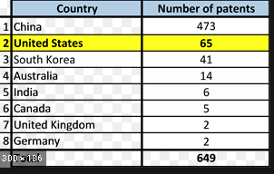
2019

Slide 4
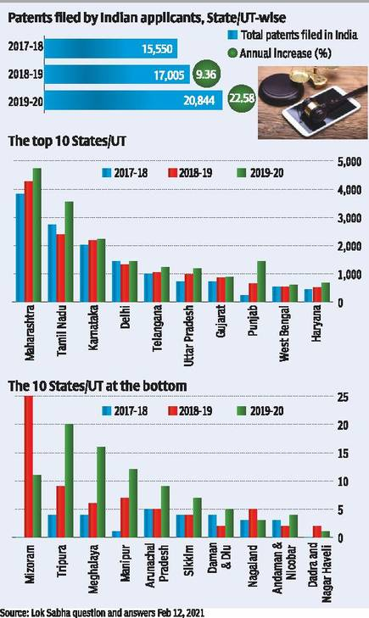

Slide 5
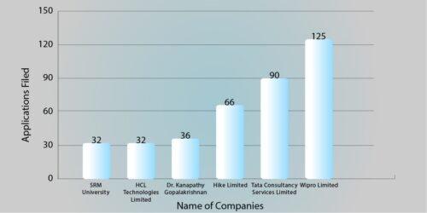

Slide 6
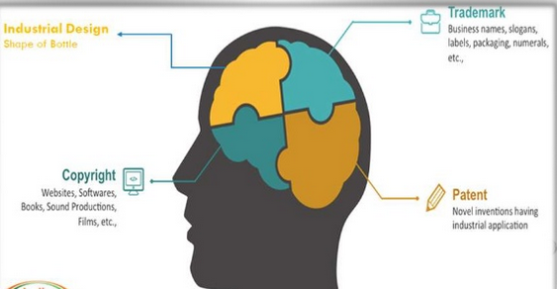
Intellectual Property Creation - Key Elements
Protection and infringement - Patents and Trade Marks
Patent licenses and purchases - legal actions and Litigations

Slide 7
Intellectual Property
It refers to creation of the mind like
Inventions
Literary and artistic works
Symbols, names and images used in business
It enables people to earn recognition or financial benefits from what they invent or create
IP system aims to foster an environment in which creativity and innovation can flourish
Examples:- patents, copyright ,trademarks. and industrial design

Slide 8
Intellectual Property Rights(IPR)
It is a right which give monopoly of any intellectual creation of mind
A combination of science and technology both
It is given for any new creation
Property
Movable
Fridge, TV,
Immovable
Land, Building
Intellectual
Book, invention, music

Slide 9
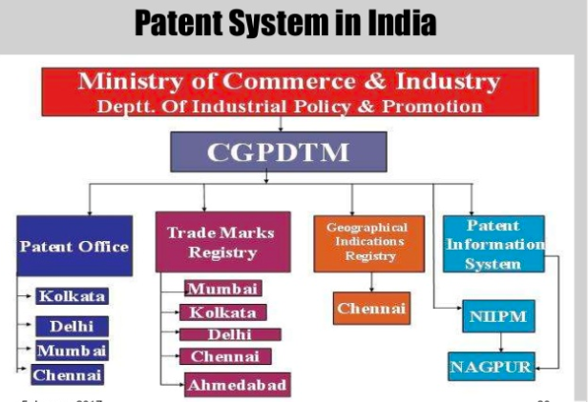

Slide 10
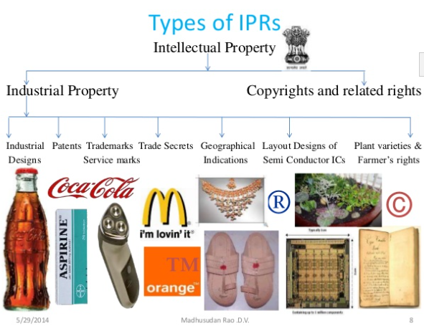

Slide 11
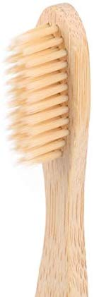
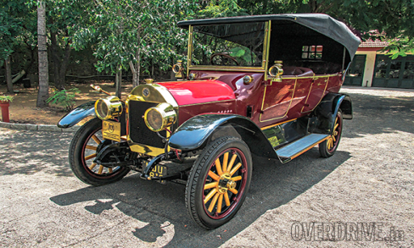

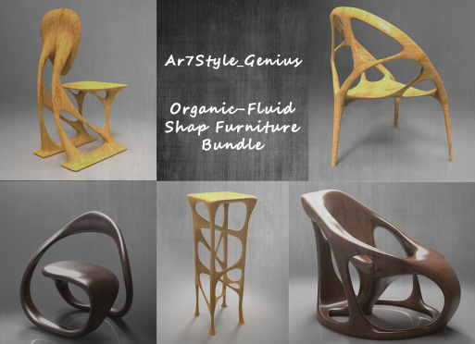
Industrial Design
An IPR that protects the design or shape, colour pattern, no. of lines, 2d or 3d design of object.
It is applied to a wide variety of products of industry or handicrafts like watches, jewellery, medical implements, etc.
It deals with features, shapes, patterns, etc. applied to an article.

Slide 12
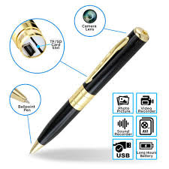
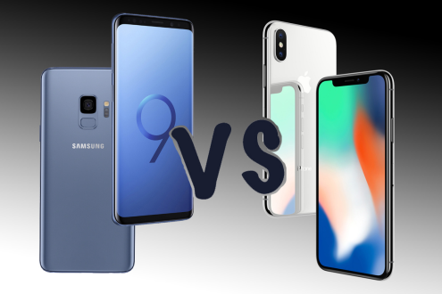
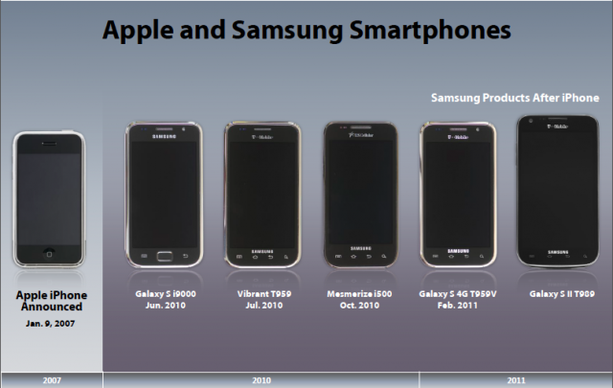
Patent / Design/Copyright
Patents deal with how the article works-functional aspect
Design deal with how the article looks- aesthetic aspect/appealing to eye.
Designs Act calls the right "copyright in the design though copyright deals with the artistic work in 2 dimension, designs act deals with such work in 3-dimension

Slide 13
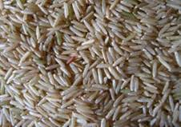
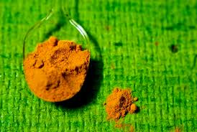

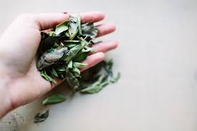
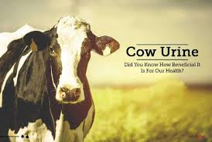
Patents
An exclusive right granted for an invention. It provides the patent owner with the right to decide how or whether the invention can be used by others.
It is a monopoly right granted to a person who invented a new product or process of making an article.
An inventor has to file for patent first and then make his invention to public and has to be applied in each country by the inventor to claim his rights in the country.

Slide 14
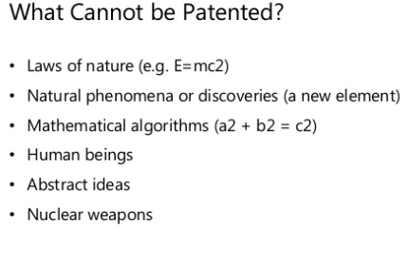
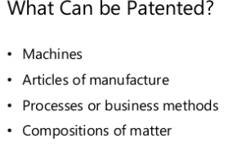
Criteria to get patent that invention
has to be Novel-not previously made available to public
has to be Inventive steps
Must have Industrial application
Types
Utility Patent:-The way the invention is used and works
Plant Patent:-Whosoever discovered any distinct and new variety of plant including cultivated, hybrid, newly found seedling, etc. other than a tuber propagated plant or a plant found in an uncultivated state.
Design Patents:- Protects the way invention looks

Slide 15
Patent Infringement
Use by a person other than the patentee or his assignee or licensee would be an infringement of the patent

Slide 16
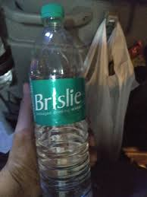



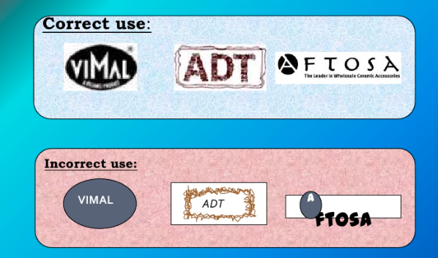
Trade Marks/Service Marks
It can be a word, name, brand symbol, label, etc., used by a company to create a unique identity for the product.
It is a sign used on or in connection with the a marketing of goods or services.
It is for an unregistered trademark, a mark used to promote or brand goods
It is for an unregistered service mark used to promote or brand services
It is used for registered trademark

Slide 17



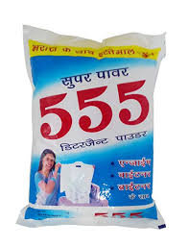


Brand:-
Brand Name:- which can be vocalized or sung
Brand marks:- Which can be recognized by symbol, design
Device :- Pictorial representations, animal, birds, landscape, etc.
Letters:- A mark is the identify created out of letterforms
Numerical:- Only numbers are used

Slide 18

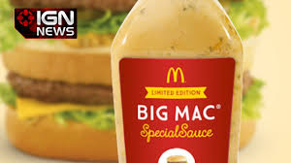
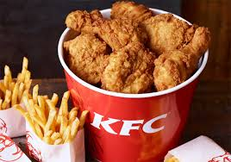
Trade Secrets
Any intellectual work of product used for a business purpose that can be classified as belonging to that business provided it is not based on information in public domain.
It is a formula, practice, process, design, instrument or pattern which is not generally known by which a business can obtain an economic advantage over competitors or customers
Those who know the secret formula have to sign non-disclosure agreements
It can only be protected through employment contracts or maintaining tight security
Recipes, ingredients, etc.

Slide 19
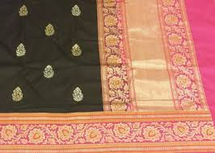

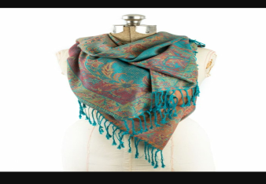
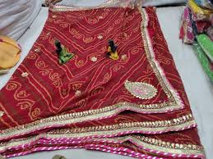
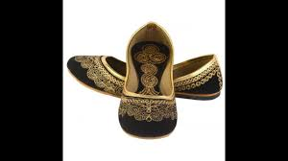
Geographical Indicator
Signs used on goods that have a specific geographical origin and possess qualities , a reputation or characteristics that are essentially attributable to that place of origin
Geographical indication of goods act of 1999 prevents unauthorised use of registered GI promotes the economic prosperity of the producers of goods produced in a geographical territory which in turn boost exports

Slide 20
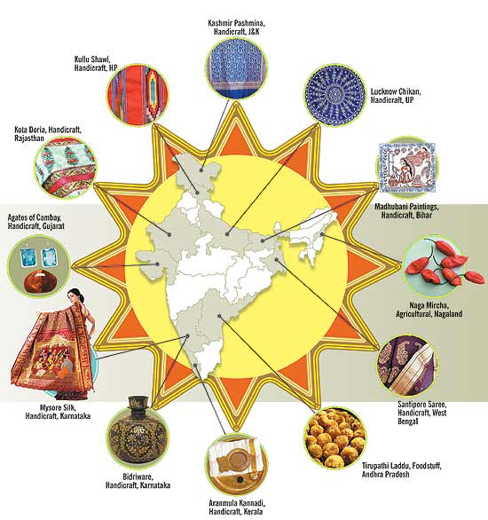

Slide 21
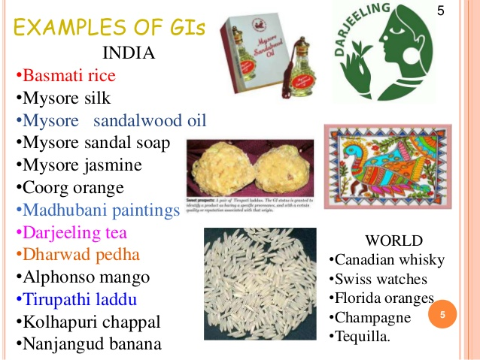

Slide 22
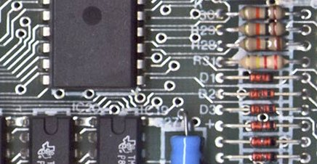
Layout designs of semi conductors
It provides protection for semiconductor Integrated Circuits (IC) layouts of transistor's and other circuitry elements.
A person when creates another layout design on the basis of scientific evaluation of registered layout design shall not be causing any infringement
Reproducing, importing, selling, distributing the IC layout design for commercial purposes only constitutes infringement.

Slide 23
Plant Variants & Farmers Right
In order to protection a breeder must file an individual application with each authority entrusted with the granting of breeders right.
International Union for the protection of New Varieties of Plants(UPOV Convention)1961 provides and promotes an effective system of plant variety protection
With the aim of encouraging the development of new varieties of plants for the benefits of society.
In India Protection of Plant Variety and Farmers Rights Act enacted in India in 2001 and came in force in 2005

Slide 24

Farmers Right
To produce, save, use, exchange and sell his farm produce or seeds of a variety protected under this act.
Farmers cannot sell branded seeds of a registered variety
Chhohartu is the first crop variety in the state to be registered under the protection of Plant variety and Farmers Rights Act in 2013

Slide 25
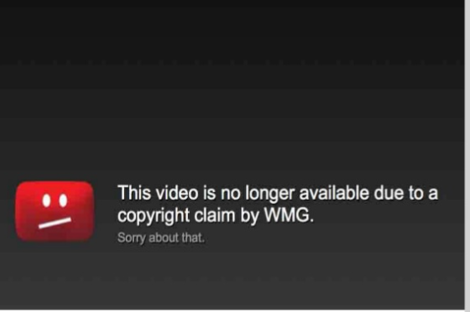

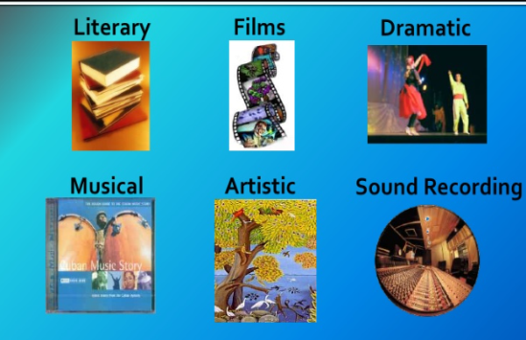
Copyright
It gives the creator of an original work exclusive rights to it usually for a limited time.
It may apply to a wide range of creative intellectual or work
Copyright does not cover ideas and information themselves only the forms or manner in which they are expressed
It is negative legal right to reproduce an original work of authorship fixed in any tangible medium of expression to prepare derivative works based on original work
Eligibility:- Work must be original, fixed or presented in a tangible form lie writing, film or photography and must be created by qualified person.
Duration:- If work for hire, 95 years from publication or 120 years from creation whichever is first
If not work of hire, life of author +70 years

Slide 26
Rights of Copyright Owners
For Reproduction
For Modification/Adaptation
For Distribution
For Public Performance
For Public Display
Copyright
Economic Right
Licensed, Assigned
Moral Right
Cannot be transferred

Slide 27
Apple Vs Samsung Design Patent War
Apple sued Samsung for copying its product idea, copied look, product design, packaging in Galaxy S, Galaxy S II, Nexus S, etc.
April 2011-Apple clamed that Samsung infringed four industrial design patents, covering the look and feel of the devices and three utility patents which cover how the gadgets work.
June 2011- Samsung countersued saying that Apple infringes on several of its patents having to do with wireless communication technology and camera phones.

Slide 28
Details of IPR and India
https://www.youtube.com/watch?v=0SS0B9lY30s
https://www.youtube.com/watch?v=nBOeGrhUhm8

